Slide 1
CSE110
Programming Language I

Slide 2
My Brief Profile
Nahian Salsabil (NNS)
Lecturer, CSE, BRACU
BSc: CSE, BUET, 2023
Email: Email: nahian.salsabil@bracu.ac.bd
Room No. UB80601
Consultation Hour:
Sunday: 11:00am - 1:30pm
Monday: 9:30am - 10:50am, 12:30pm - 1:30pm
Wednesday: 9:30am - 10:50am

Slide 3
Links
Resources: http://tiny.cc/cse110_resources_NNS
Slack: http://tiny.cc/cse110_slack

Slide 4
Outline
Function

Slide 5
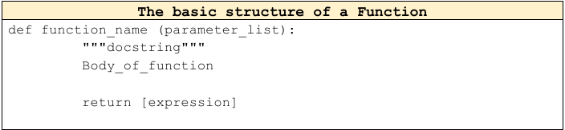
Basic Structure of a Function

Slide 6
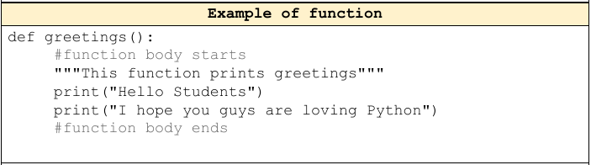
Example

Slide 7
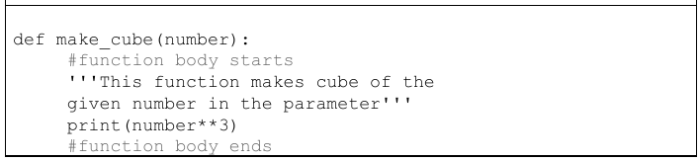
Example

Slide 8
Function Definition
Def
Name_of_Function
Parameters
Body of Function

Slide 9
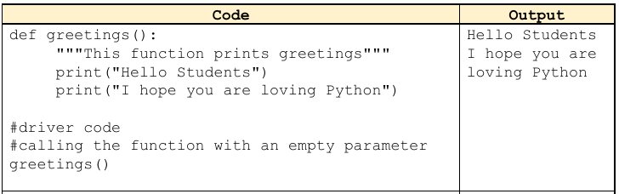
Function Call/Invocation

Slide 10
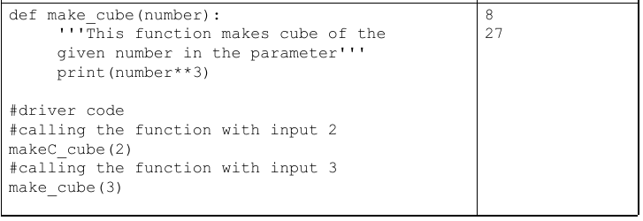
Function Call/Invocation (contd)

Slide 11
Parameters (Arguments)
Parameters: Parameters are the variables declared in the function.
Arguments: Arguments are the values passed through the parameters when calling the function.

Slide 12
Arguments
Positional Arguments
Default Arguments
Keyword Arguments

Slide 13
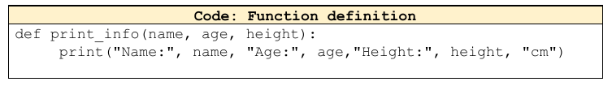
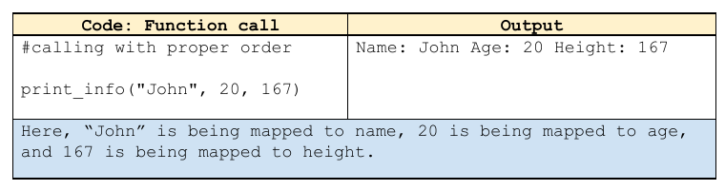
Positional Arguments

Slide 14
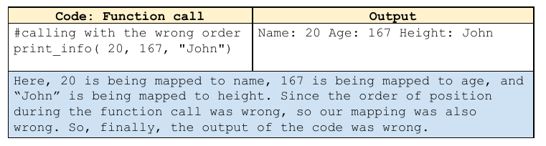
Positional Arguments

Slide 15
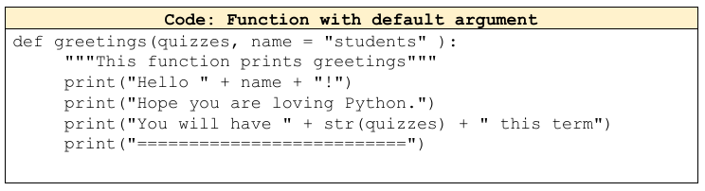
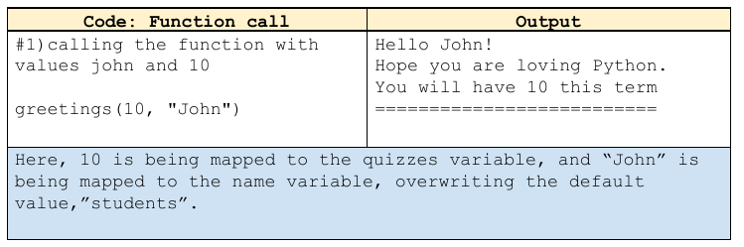
Default Arguments

Slide 16
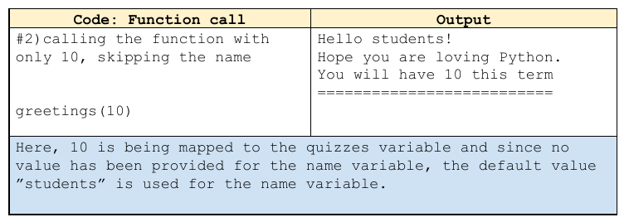
Default Arguments

Slide 17
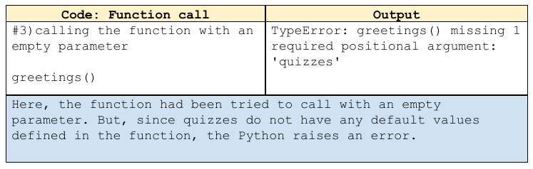
Default Arguments

Slide 18
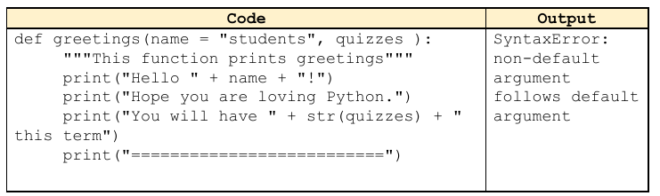
Default Arguments
the non-default argument(parameter with no defined values) must come before the default argument (parameter with defined values

Slide 19
Keyword Arguments
all the arguments must be provided, but they can be in random order

Slide 20
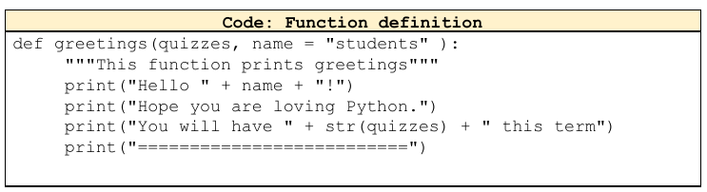
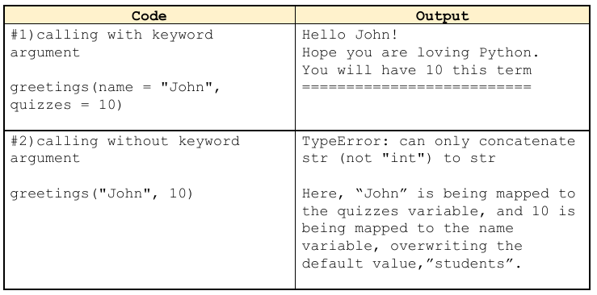
Keyword Arguments

Slide 21
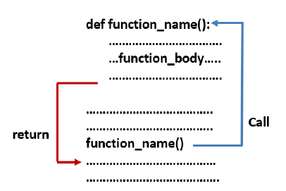
Return Statement

Slide 22
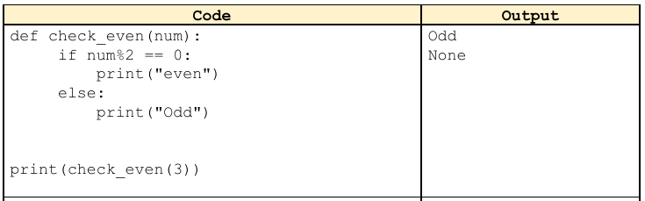
Return Statement

Slide 23
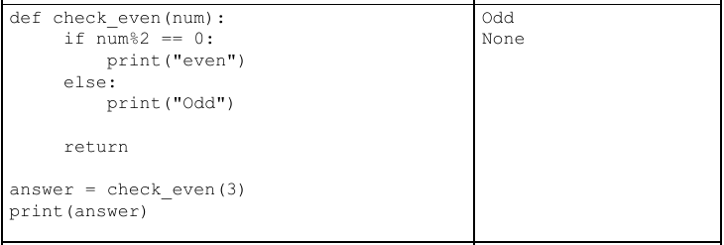
Return Statement

Slide 24
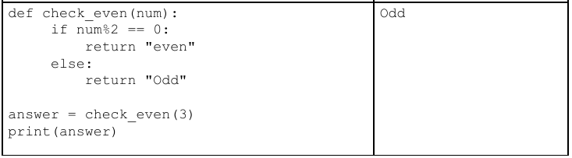
Return Statement

Slide 25
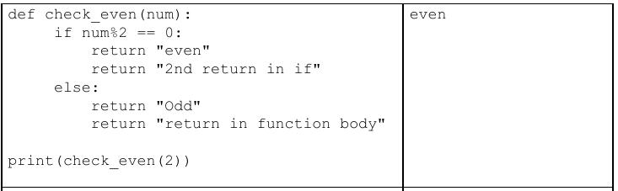
Return Statement

Slide 26
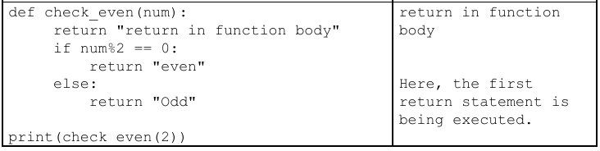
Return Statement

Slide 27
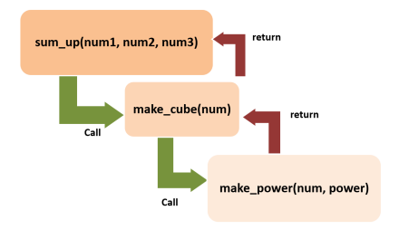
Example Task
Write the code for this problem.

Slide 28
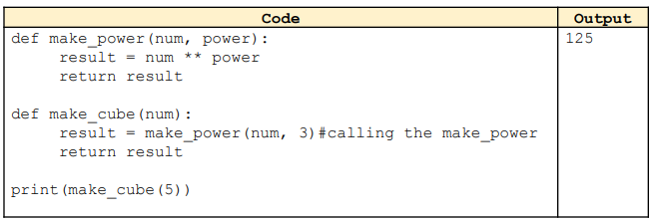
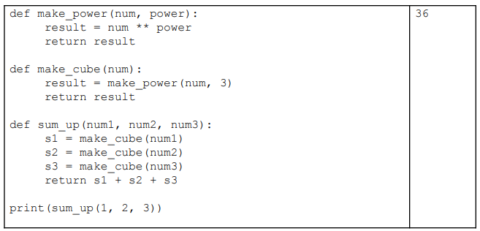
Example Task

